Slide 1
Natural language to SPARQL
IMPRINT 2 KNOWLEDGE GRAPH 04-07-2020
Qumar Ibrahim

Slide 2
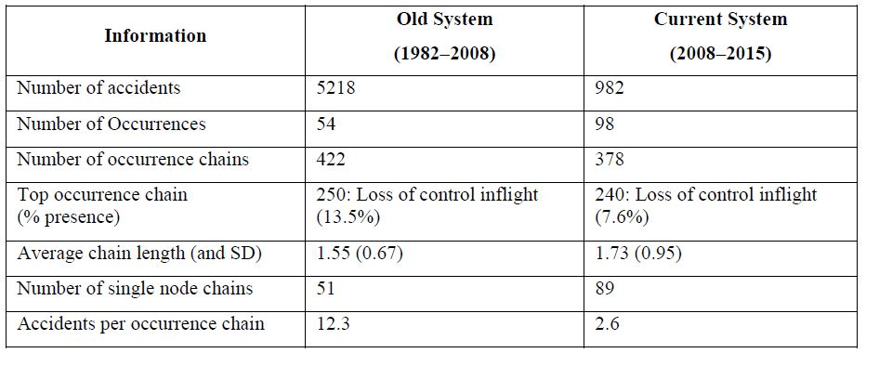
NTSB Cause Analysis

Slide 3
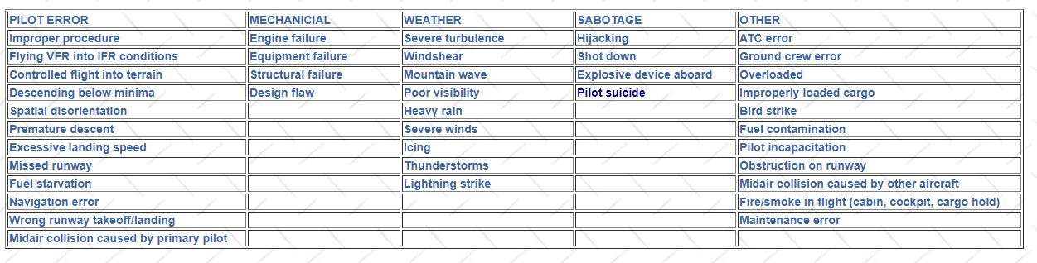
Types of Aircraft Accident Causes

Slide 4
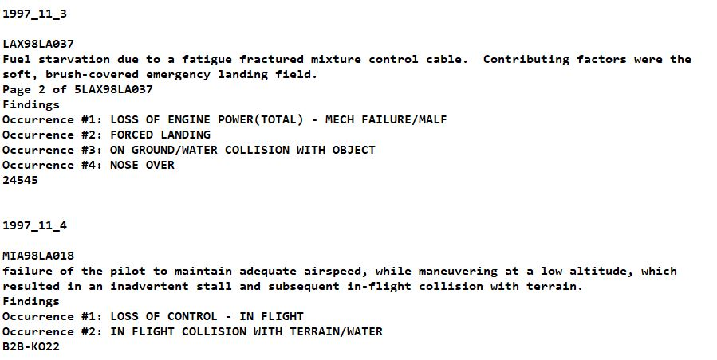

Slide 5
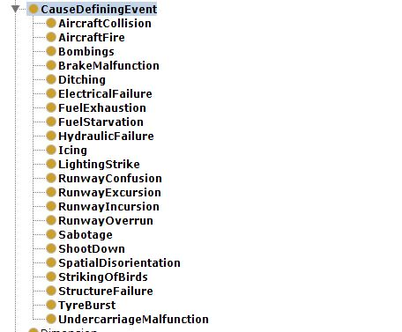
Ontology Classes

Slide 6
References:
A new approach to modeling aviation accidents, Arjun Harsha Rao, Purdue University
Aircraft Accidents: Methods of Analysis- By DR. J. S. AMES, p760-772 Seventeenth Safety Congress, Passenger Safety.

Slide 7
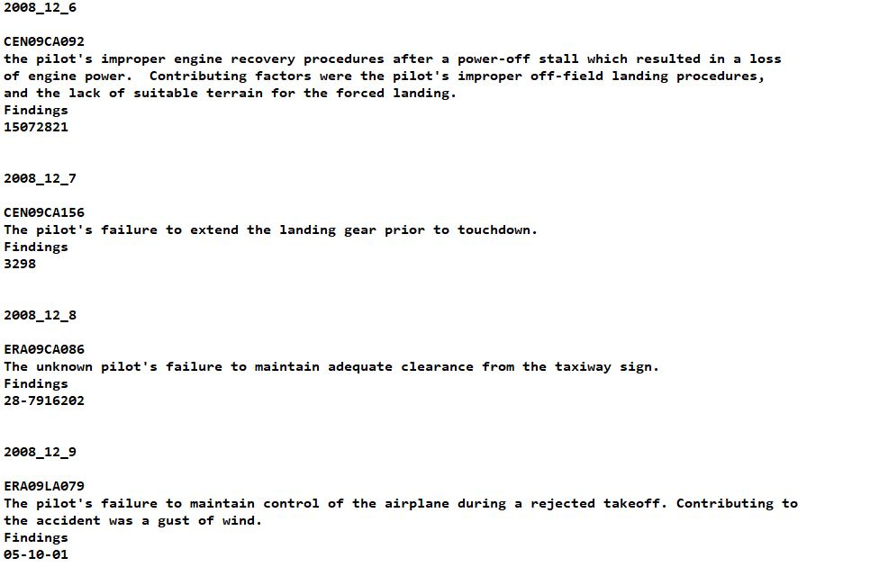

Slide 8
Problems in Accident cause Analysis
Event Sequence Generation to create Taxonomy of Accident causes.

Slide 9
Reading about Generation of Event Sequence
Nikola Tulechki. Natural language processing of incident and accident reports : application to risk management in civil aviation. Linguistics. Université Toulouse le Mirail - Toulouse II, 2015. English. ffNNT : 2015TOU20035ff. Fftel-01230079f
https://tel.archives-ouvertes.fr/tel-01230079/document
Verhagen, Marc & Gaizauskas, Rob & Schilder, Frank & Hepple, M. & Moszkowicz, Jessica & Pustejovsky, James. (2009). The tempEval challenge: Identifying temporal relations in text. Language Resources and Evaluation. 43. 161-179. 10.1007/s10579-009-9086-z.

Slide 10
Thank you

